Slide 1
ASL Classification
CS-UY 4563 Final Project
Nikita Pola & Paule Kairyte

Slide 2
Introduction
01
IN DEPTH
02
Modeling
Pre-processing
TABLE OF CONTENTS
04
03
Conclusion
05
Questions
06
How we chose our project & background
Overview of process & modeling done
Discussing the three models tested
Manipulating the data
Discussing observations and final results
Any questions & thank you for listening!

Slide 3
01
Introduction
Background information & relevance

Slide 4
the numbers.
12 mil
2 mil
500k
Hearing loss in the USA
Classified as deaf
Using ASL

Slide 5
The problem
accessibility
to learning ASL due to varying environments
ASL
American Sign Language
technology
reliability
Having ASL relevant in all environments of thee individual
Integrating ASL into technology
Text to speech

Slide 6
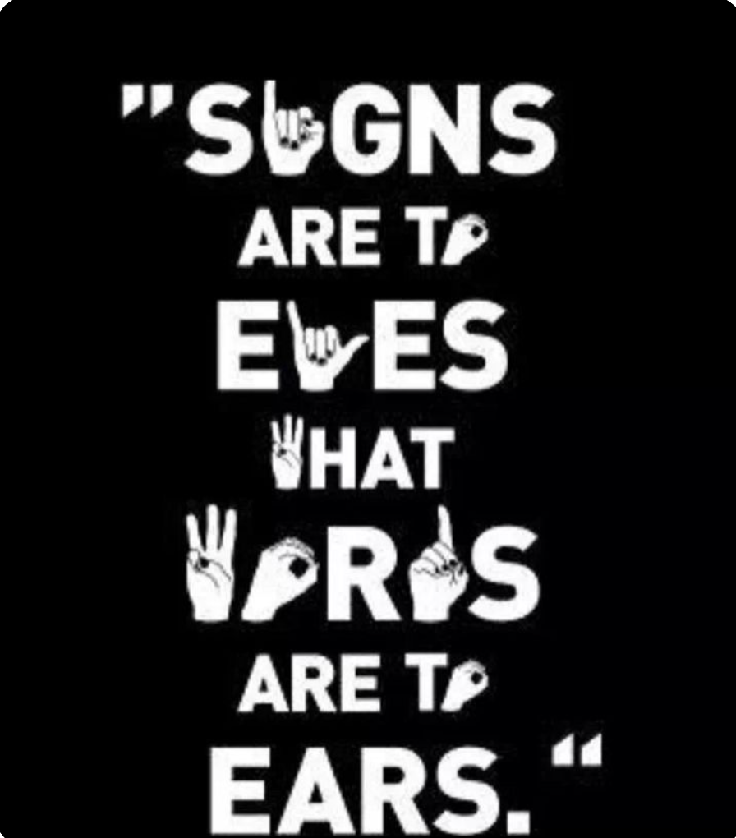
American Sign Language
“Signs are to eyes what words are to ears”

Slide 7
02
IN DEPTH
Overview of process & modeling

Slide 8
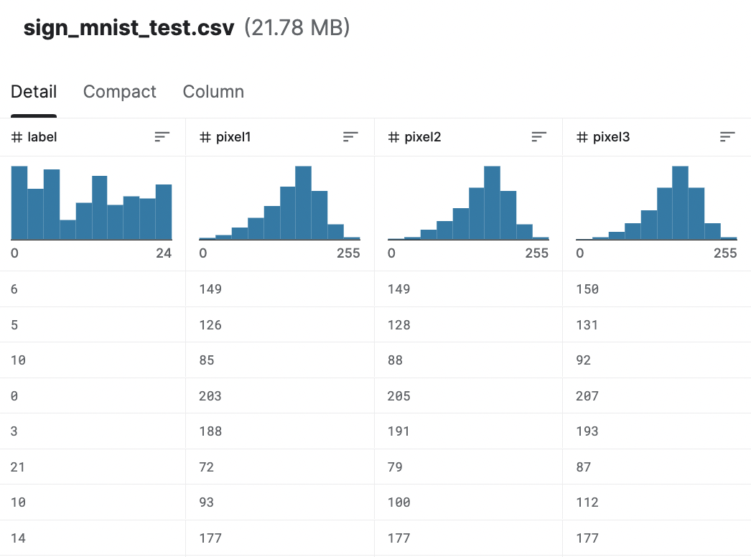
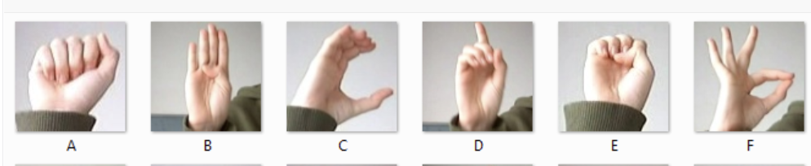
784 pixel features
The Data
Labels, 0-24
… #pixel784
Representing A-Z,
omitting letters j, z

Slide 9
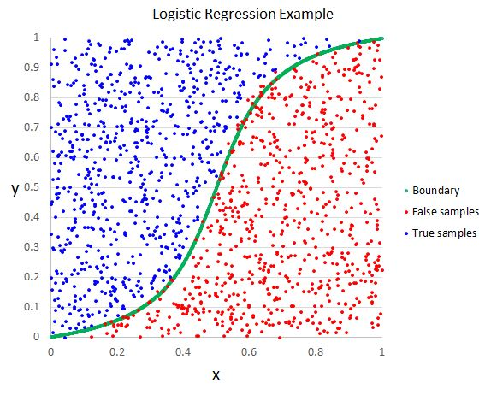
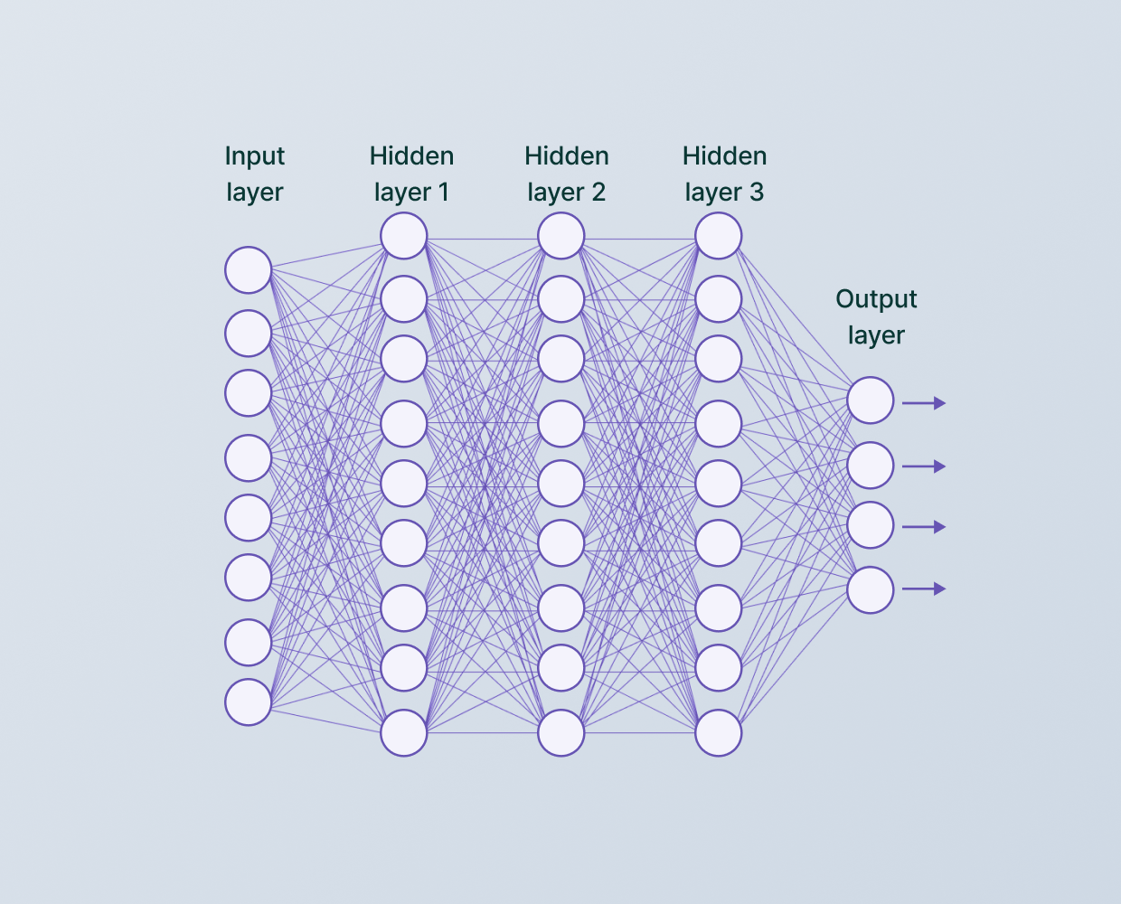
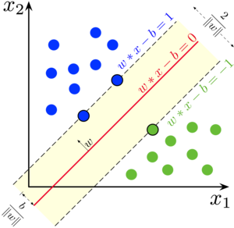
Models Tested
Logistic Regression
SVM
CNN

Slide 10
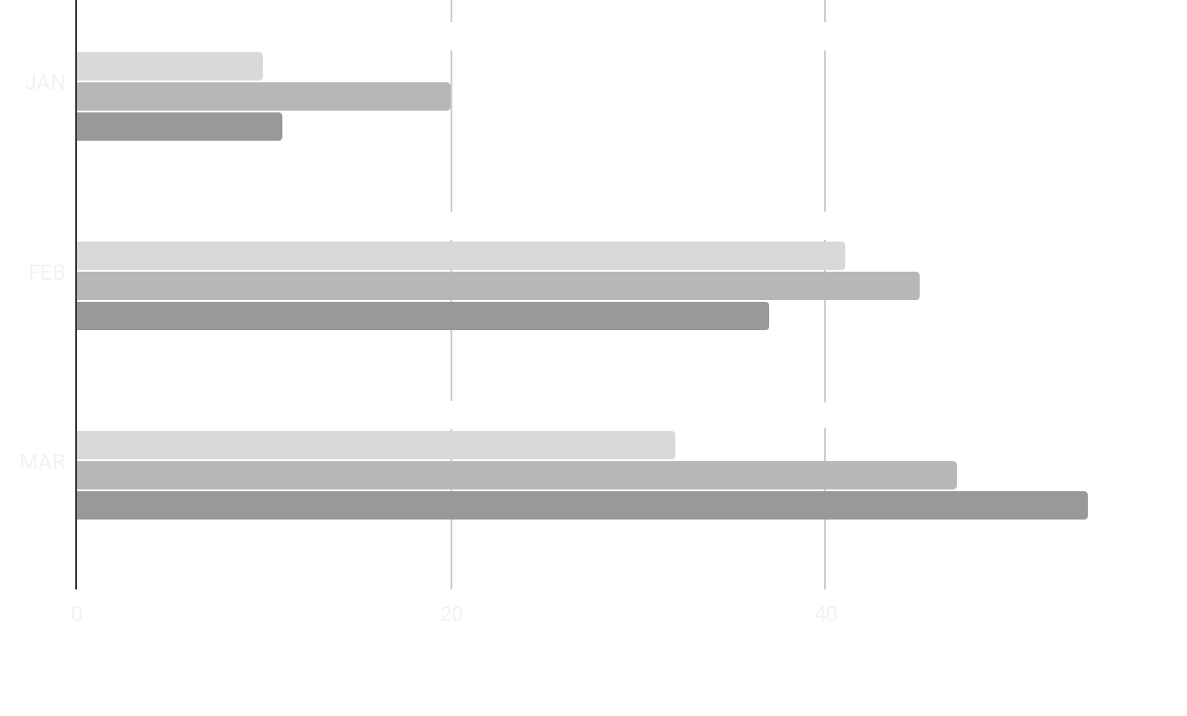
GOAL
Training Data
Testing
Data
Training
Loss
Testing
Loss
Accuracy
SVM
Achieve high accuracy classification models!
Logistic
CNN

Slide 11
03
Pre-processing
Manipulating the data

Slide 12
NEWS
Data
Labels
Pixel Features
Separating Data
Reshaping the labels
Normalizing pixel features
CSV file with labels and pixel features
Neptune is the farthest planet from the Sun
Grayscale values between 0 and 255
Separating the labels from the pixel features
Scaled each pixel feature to be between 0 and 1
Scaled each pixel feature to be between 0 and 1

Slide 13
04
Modeling!
Testing SVM, Logistic, and CNN Models

Slide 14
Logistic Regression
Transforming Features
Squared
Cubed
No transformation
Regularization
Lasso
Ridge
Elastic-Net

Slide 15
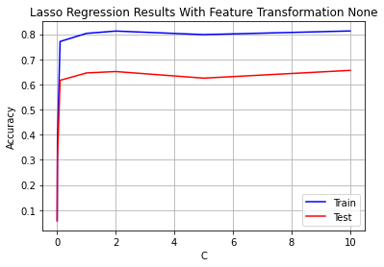
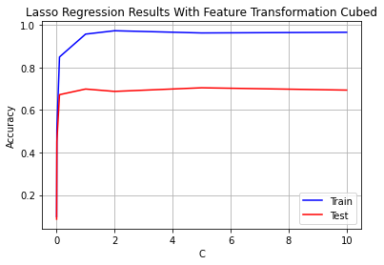
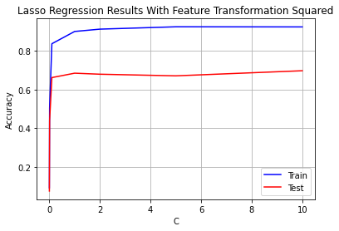
Lasso Regularization
(similar was done for ridge, elastic-net)

Slide 16
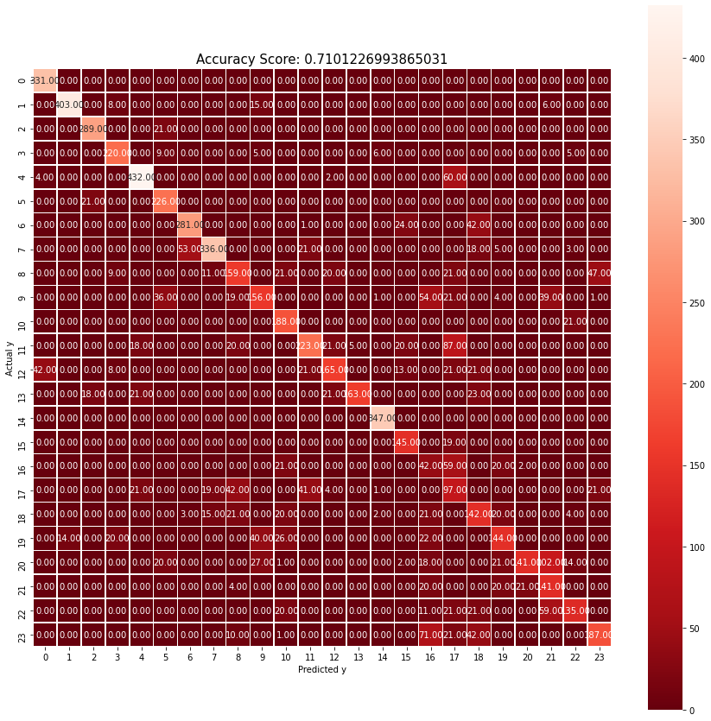
OPTIMAL PARAMETERS! 😊
Cubed feature transformations
Ridge regularization
C-value of 0.1
Accuracy: 71%

Slide 17
SVM
Testing Parameters
Kernel
C values
Additionally
K-Cross Fold Validation
Polynomial Degree
Regularization

Slide 18
SVM Testing
Kernel | C | Testing Accuracy (%)
Linear | 1 | 78%
Poly | Degree=3 | 78%
RBF | .1 | 84%

Slide 19
OPTIMAL PARAMETERS! 😊
RBF
C-value of 0.1
Accuracy: 78%

Slide 20
CNN
Testing Parameters
Number of Layers
Regularization Term
Additionally
Leaky Relu
Tanh
Linear
RELU

Slide 21
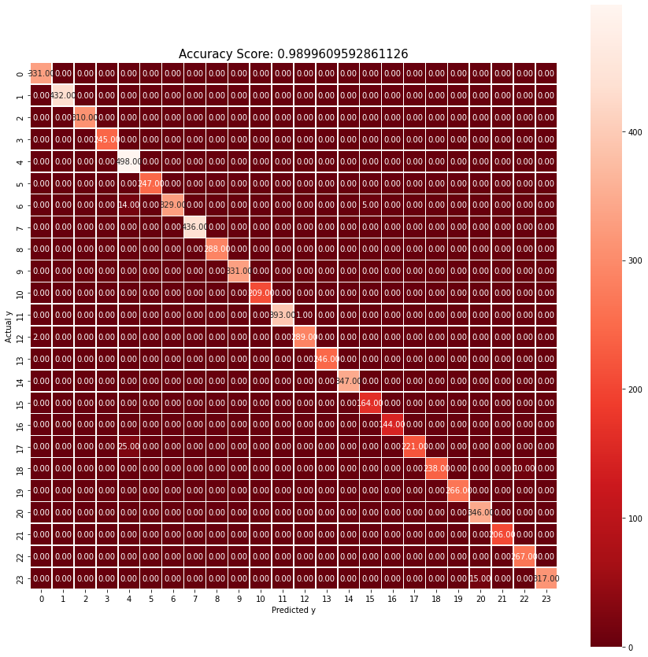
OPTIMAL PARAMETERS! 😊
5 layer model,
L2 Regularization
Accuracy: 99.0%

Slide 22
05
Conclusion
Discussing Observations & Findings

Slide 23

Observations
Overfitting & underfitting were extremely important to attend to
Tuning parameters and testing various functions / libraries is key
Factors like dataset size, etc. can lead to inherent
impact on performance

Slide 24
The hope 🙏🏽
Interconnectedness of our world
Sign language speakers across the world
Bridging disparities

Slide 25
06
Thank you!

Slide 26
THANKS for listening
Does anyone have any questions?

